Slide 1
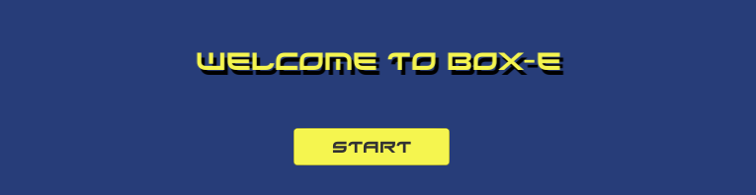

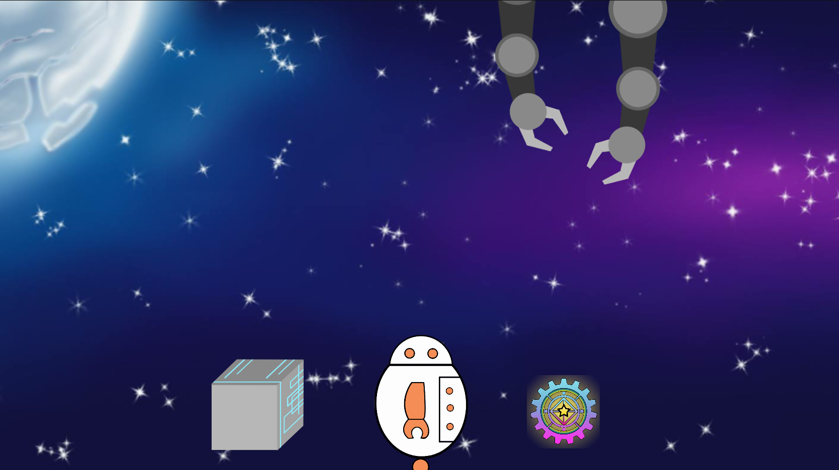



Team 51 BOX-E
A cute user-controlled game.
Curated by Minh-Tam Do, Tiffany Chenn, Émilie Martin, and Daniela Venuta for ConUHacks2019

Slide 2
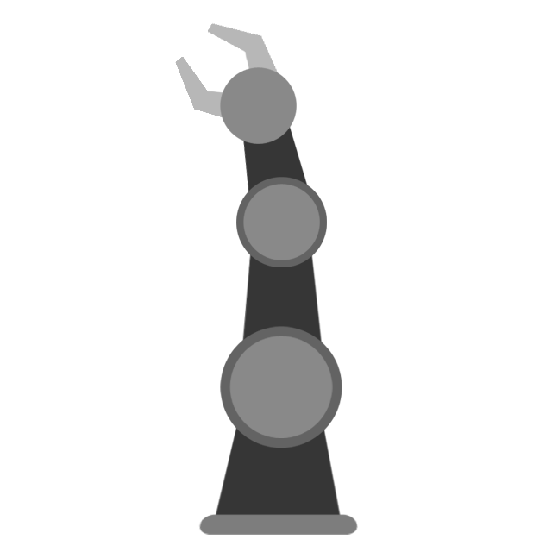

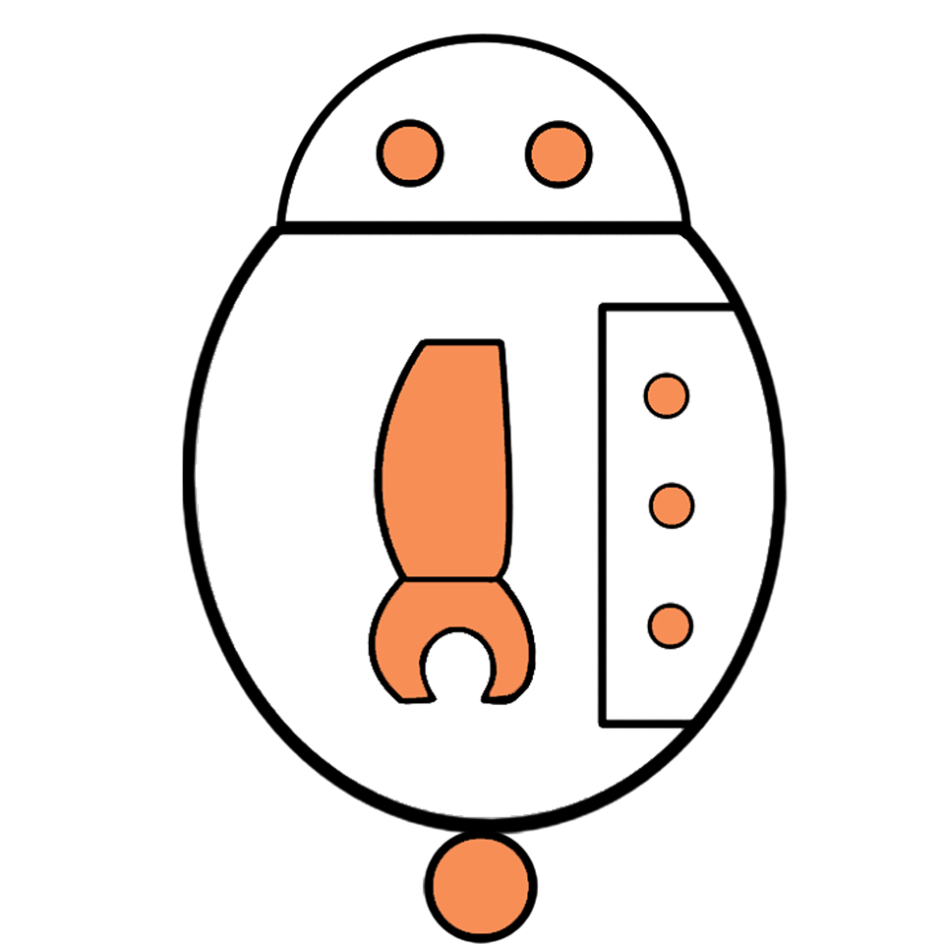



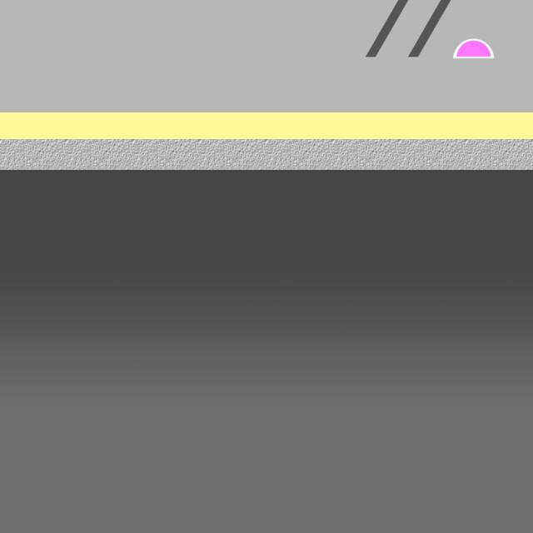
Basic Introduction
Hello! My name is Box-E and I am a robot.
My goal is to collect these Crystal Gears.
Box-E is a short interactive game geared towards helping a small, adventurous robot get his claws on magical items. The user is tasked with collecting various crystal gears while simultaneously avoiding dangerous obstacles.
I need to avoid Mechanical Arms and Moving Boxes to survive!

Slide 3



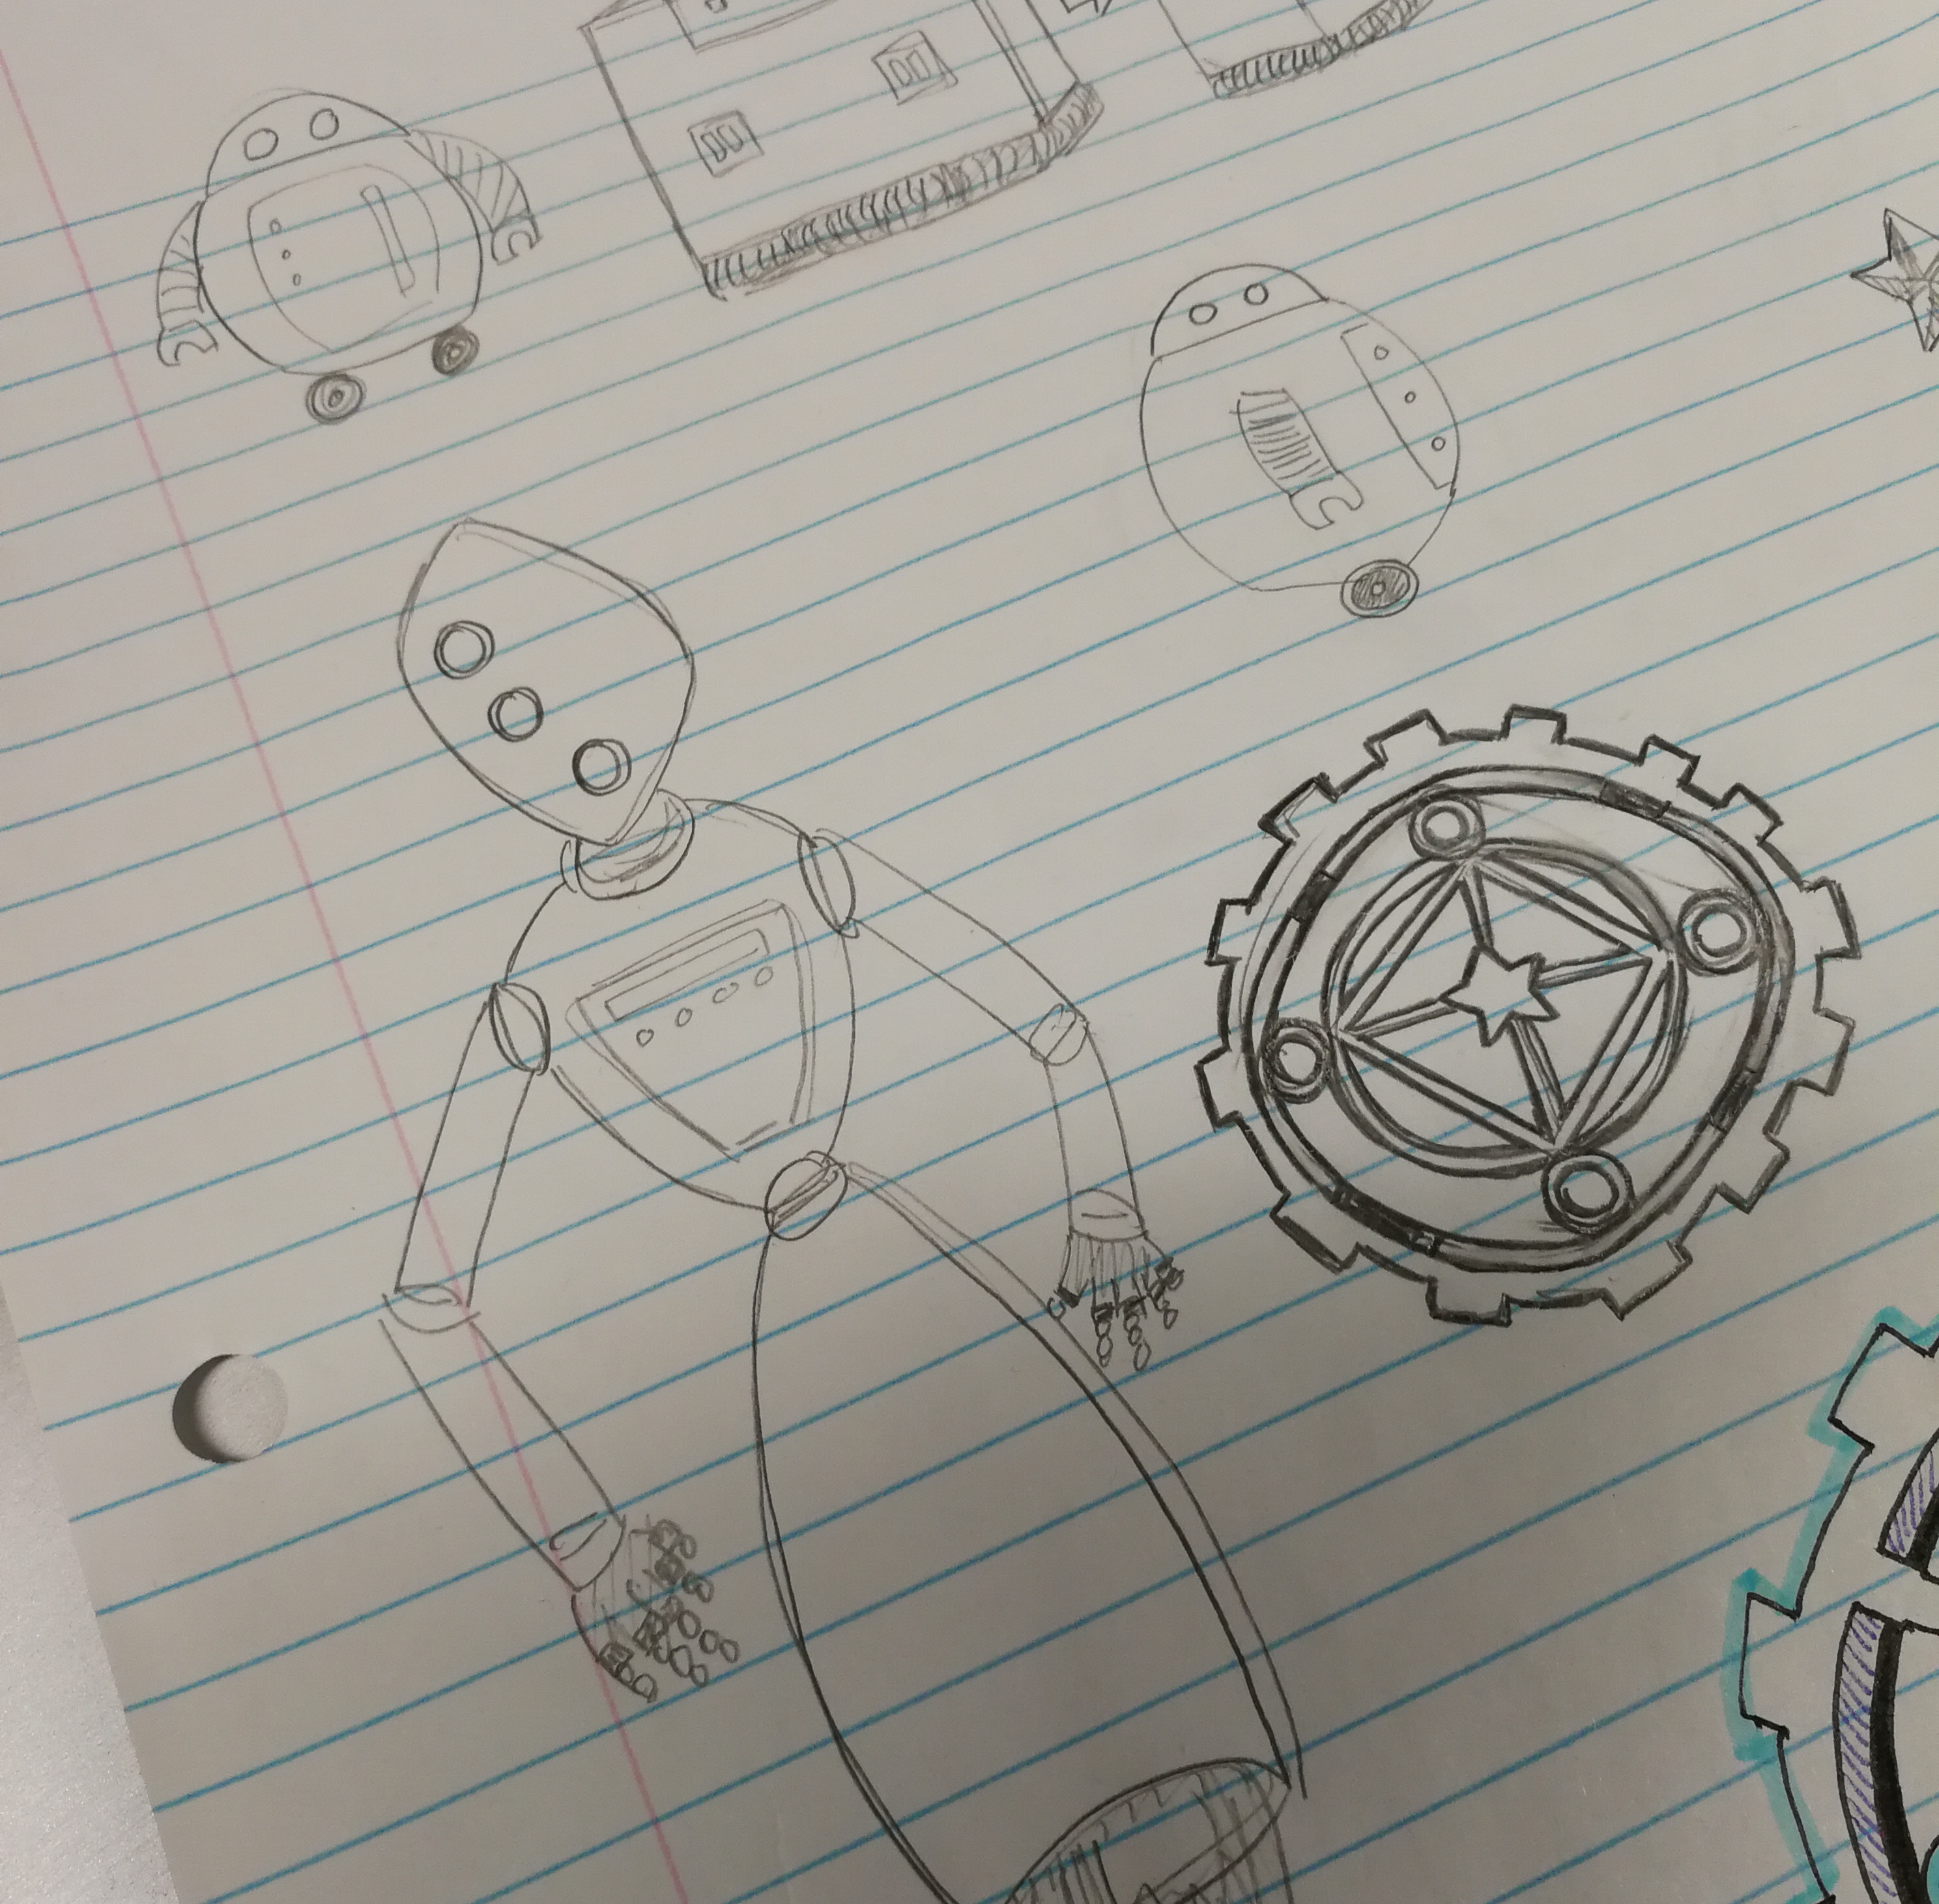
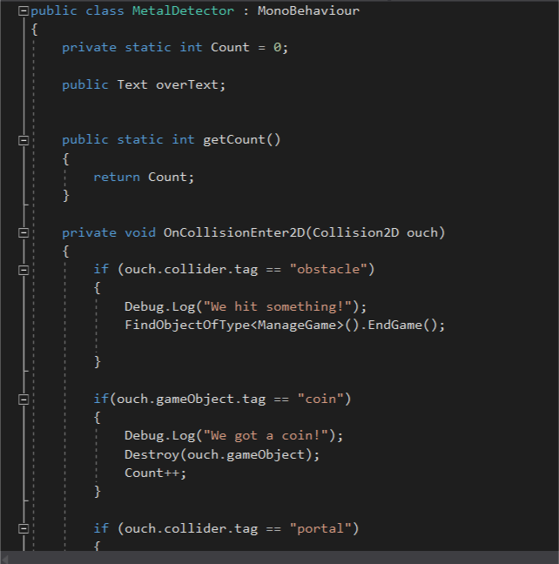
Used Programs
Unity (C#)
Photoshop
New experience with the language and library
Ran into many errors along the way
Relied on online resources to debug code
Digitally transferred hand-drawn designs by means of the Photoshop interface

Slide 4


DEMO
Warning: playing this game may result in utmost frustration
Here are a few tips before starting:
Try to catch as many gears as you can
Beware of mechanical boxes and moving arms!
Movement keys:
Use the right arrow to move forward
Use the left arrow to move back
Have a go at our game!
Tip: you cannot hold the space bar to continuously jump. You must press the key multiple times.
Use the space bar to jump

